Slide 1
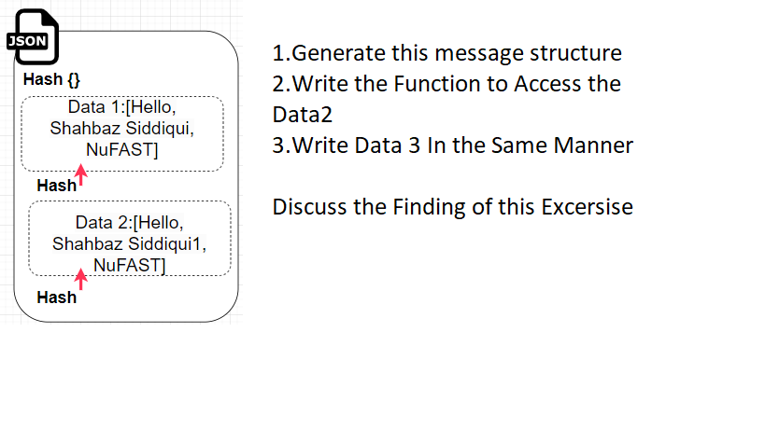
Task-1 With Client Server Program having 2 Client A and B and Server
Sending Message: A->Server A->Server->B B ->Server->A
Task-1 With Client Server Program
Group Task
Marks 0.5
Focus :Implementation of Data immutability also Verification of this Concept, No use of encryption of data is used

Slide 2
Task-1 With Client Server Program having 2 Client A and B and Server
Sending Message: A->Server A->Server->B B ->Server->A
Shahbaz Siddiqui :Fast Nu
Shahbaz Siddiqui2 :Fast Nu
Hash {Message2}
Hash {Message}
Store Hash2
Store Hash1
Client A
Client B
Server
Json {H(Message):Message}
Focus :Implement the Function of Update in which traverse the linked list
Json {H(Message2):Message2}

Slide 3
Task-2 Implement the concept of Goofy Coin
Sending Message: A->Server A->Server->B B ->Server->A
Task-2 With Client Server Program having 2 Client A and B and Server
Sending Message: A->B 10 Change the OwnerShip
Group Task
Marks 0.5
Focus :Implementation of Goofy Coins .Implement Public and Private Key
Rules Such as Create Coin Pay to script

Slide 4
Task-2 With Client Server Program having 2 Client A and B and Server
Sending Message: A->B 10 Change the OwnerShip
Receive the Message
Dec(M) First then Verify Hash
in the Database
(Coin :10 Sign with Private Key )
Encrypt(M) with Public Key
Singned||Enc(Message)
Display the message
Then Signed With own Private
Key
Client A
Client B
Focus :Implementation of Goofy Coins .Implement Public and Private Key
Rules Such as Create Coin Pay to script

Slide 5
Task-3 Implement the concept of double Spending Problem
Group Task
Marks 1
Focus :Implementation of Goofy Coins
Rules Such as Create Coin Pay to script

